Slide 1
Bacterial Foraging Optimization (BFO)
Momčilo Vasilijević
Vm153390m@student.etf.rs

Slide 2
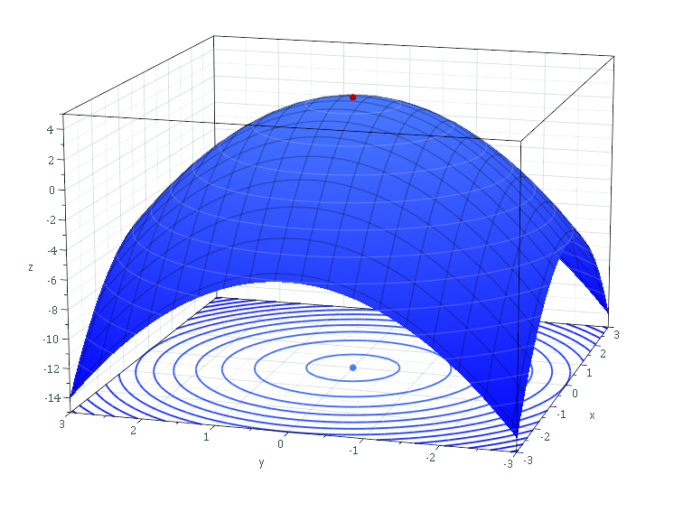
Optimization problems
Selection of a best element (with regard to some criteria) from some set of available alternatives
Maximizing or minimizing a real function
Many methods for solving
  Gradient descent
  RMSPROP
  Hessian-free optimization
  Evolutionary algorithms

Slide 3
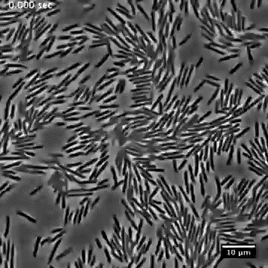
Biological inspiration
Foraging behavior of E. coli
Swimming up a nutrient gradient
Swimming in groups
Concentric patterns of swarms with high bacterial density

Slide 4
Bacterial foraging optimization algorithm
Chemotaxis
  Simulates the movement of an E.coli cell
  Swimming and tumbling via flagella
Swarming
  Group of E.coli cells arrange themselves in a traveling ring
Reproduction
Elimination and dispersal

Slide 5

Chemotaxis
Motion patterns in the presence of chemical attractants and repellents
Modeling movement of single bacteria
Choose random direction $Δ\left(t\right)$
Move from current position $θ\left(t\right)$ to next position $θ\left(t+1\right)$ if next position is better, w.r.t cost function $J_{cost}(Θ,t)$
$θ\left(t+1\right)=θ\left(t\right)+CΔ(t)$

Slide 6
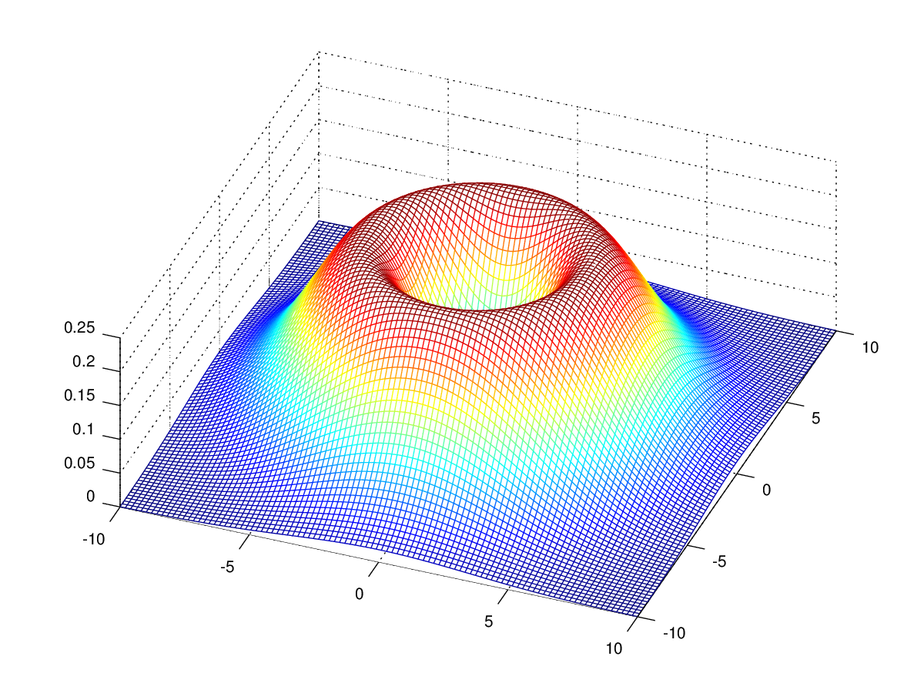

Swarming
Simulating spatio-temporal patterns (swarms)
Arranging bacteria in rings
Cell-to-cell cost
$J_{cc}=$
$\sum_{i=1}^{S}{−d_{att}e^{−w_{att}{\left|θ−θ_{j}\right|}^{2}}}+\sum_{i=1}^{S}{−d_{rep}e^{−w_{rep}{\left|θ−θ_{j}\right|}^{2}}}$
$J_{cost}=J+J_{cc}$

Slide 7

Pseudo code
For each elimination-dispersal
  For each reproduction
    For each chemotaxis
      For each bacteria
        Calculate cost function $J_{last}= J_{cost}\left(θ\left(t\right)\right)$
        Tumble: generate $Δ$
        For I = 1 to M
          Swim: $θ\left(t+1\right)=θ\left(t\right)+C∙Δ$
          If $J_{cost}\left(θ\left(t+1\right)\right)<J_{last}$
            Update $J_{last}$
            Update $θ$
          Else break
    Reproduce
  Eliminate and disperse

Slide 8

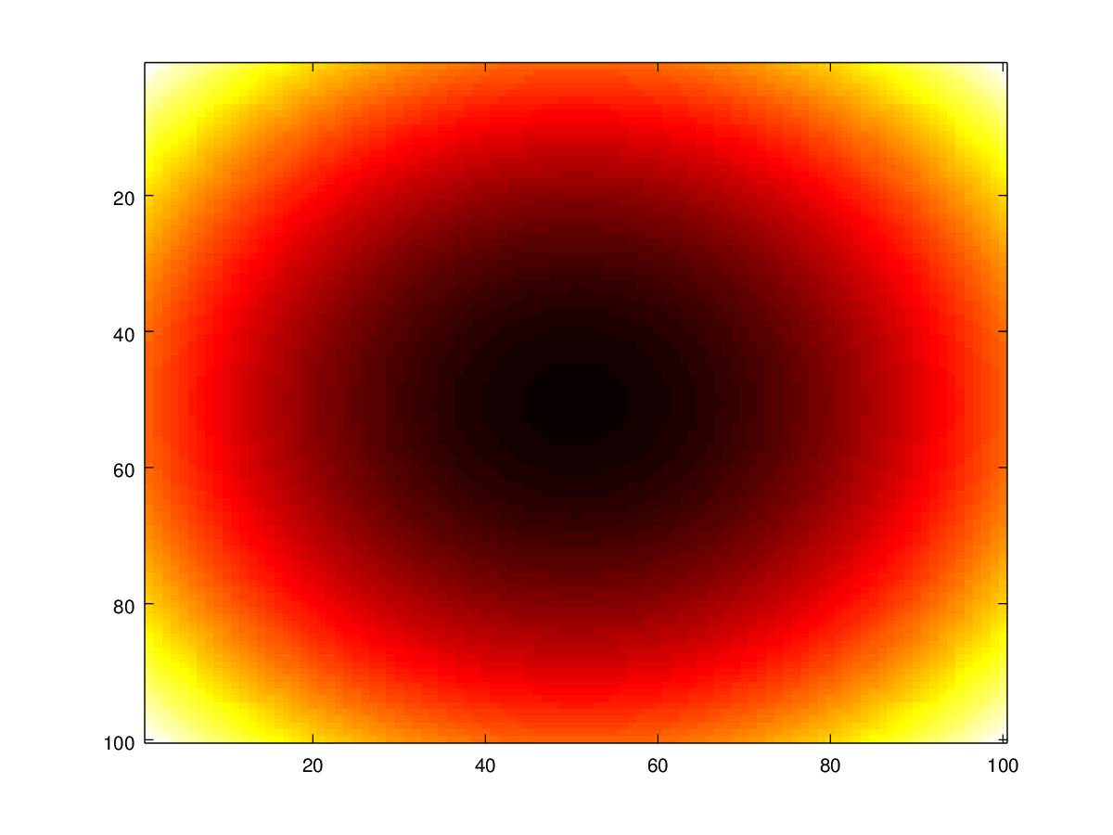
Demo

Slide 9
Applications
Training neural network for short term electric load forecast
Image enhancement
  Tuning adaptive median filter
  Improve peak signal to noise ratio of a highly corrupted image
Tuning of PID (proportional derivative integral) controller parameters

Slide 10

Pros and cons
Pros
  Simple implementation
  Easy to distribute
  No local minima problem
  No need for gradient
  Fitness function can change over time
Cons
  Complexity $O\left({ColonySize}^{2}\right)$
  Too many parameters to tune
  Fixed search step

Slide 11
Q/A
Thank you for your attention!
Momčilo Vasilijević, 15/3390
vm153390m@student.etf.rs

